Slide 1
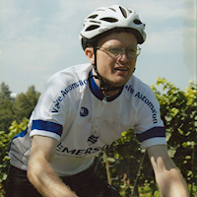
How I Taught My Bike to Fly: Brain Injury Therapy with a Joystick
https://www.posthope.org/team-todd

Slide 2
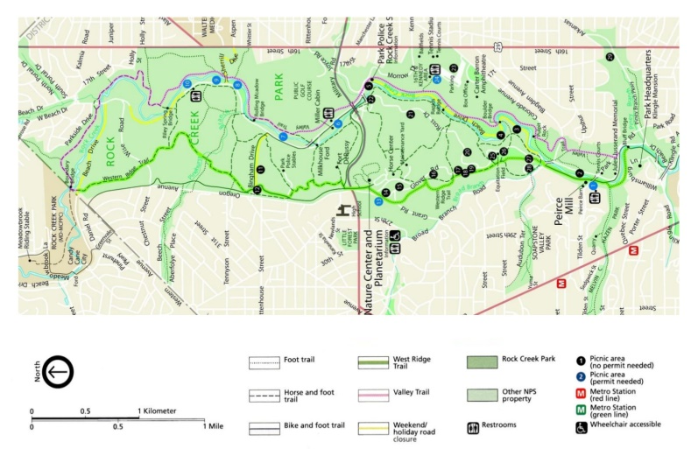
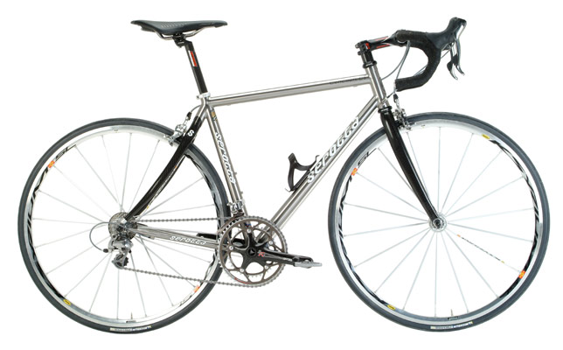
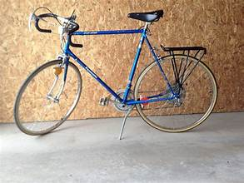
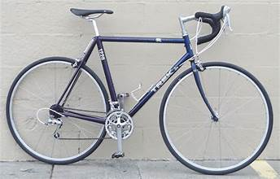
Prelude
Rock Creek Trail
Serotta Concourse CS Ti
$20 Bike in College
Trek 1220

Slide 3
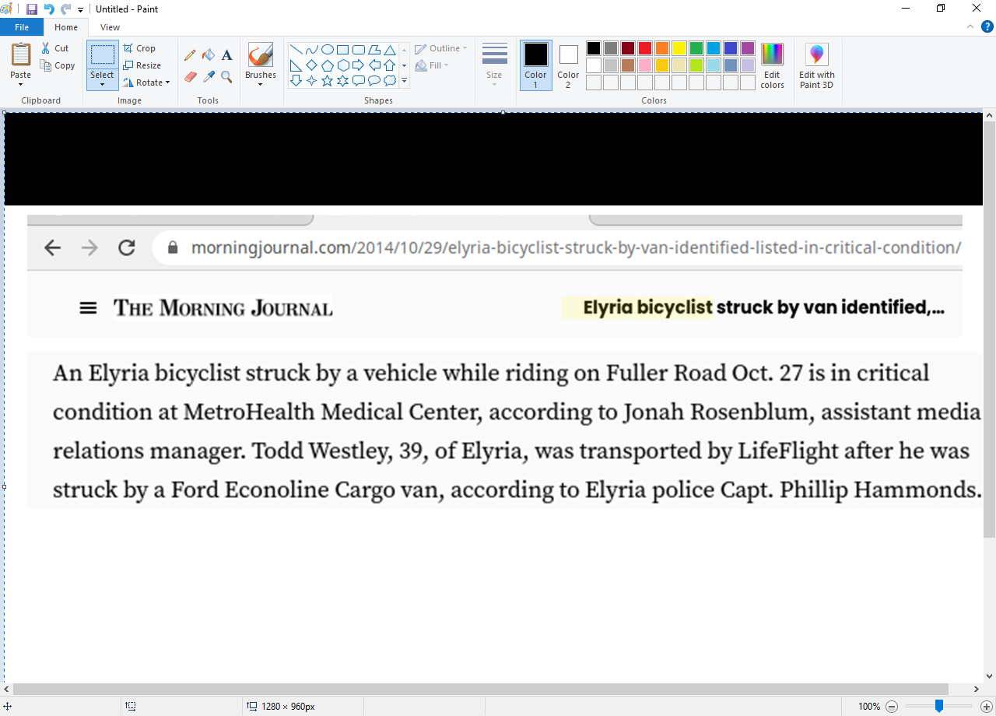
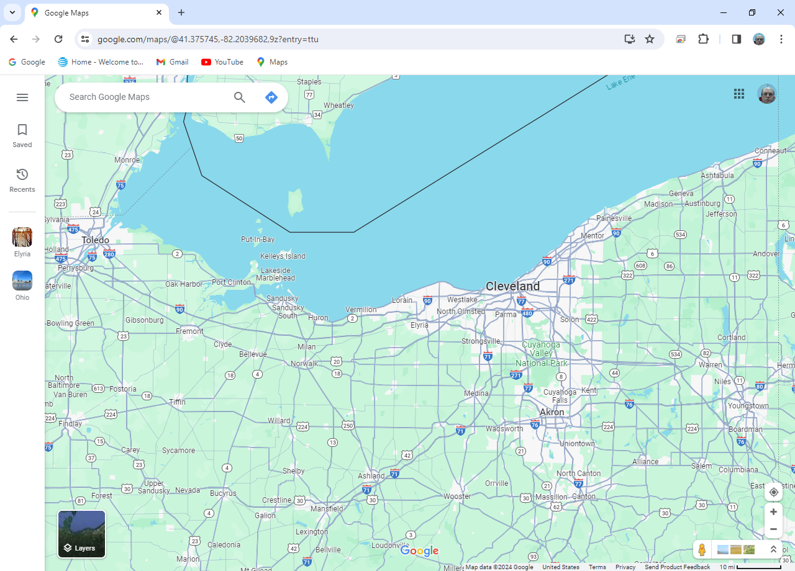
Justification Why Todd is Presenting
Todd resided here
Notes:
This article describes how I got my brain injury.
Note: I lived in Ohio at the time

Slide 4
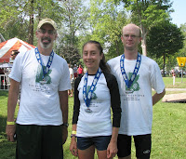
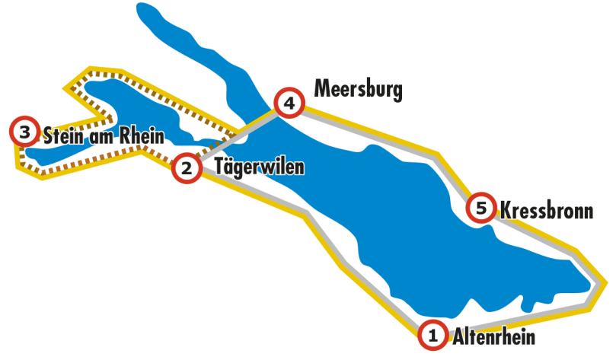
Presentation Background
I have been a cyclist since college:
Cyclist on relay team that won a Triathlon
In Vermillion Ohio
Completed
200 km ride around European Lake Constance
while I worked in Switzerland for 6 months.
Lake Constance
Notes:
Thank you…
Background – I have been riding since I was 20.

Slide 5
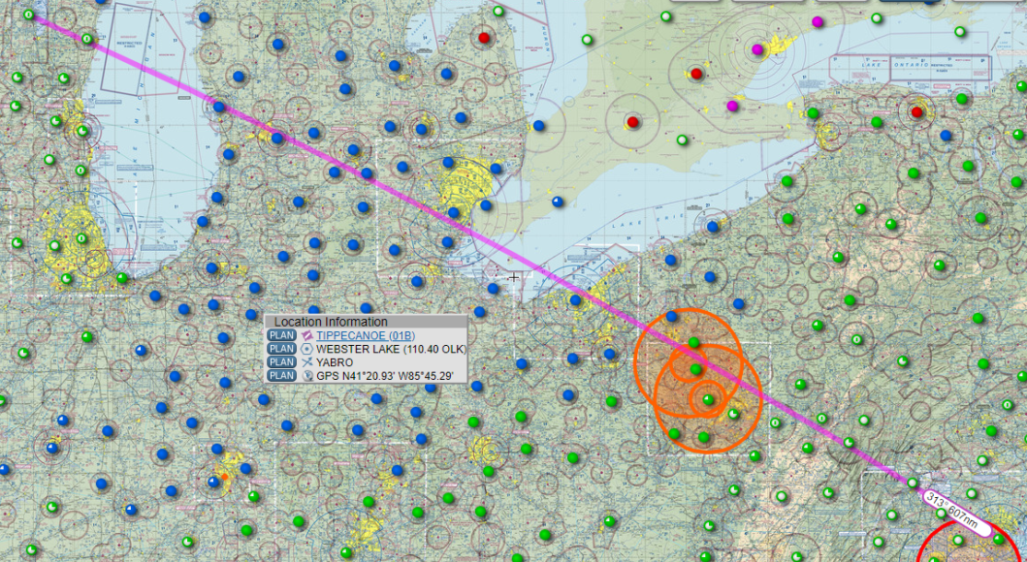

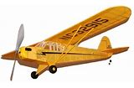
How Todd Got Involved in Aviation
Went to a few airshow s in Oshkosh, WI with Uncle Steve when I was young.
EAA
When I was older, I worked on Steve’s project to build Piper Cub from plans.
Notes:
Went to air show in Oshkosh Wisconsin with Uncle Steve
After college, he started building a Piper Cub from plans

Slide 6
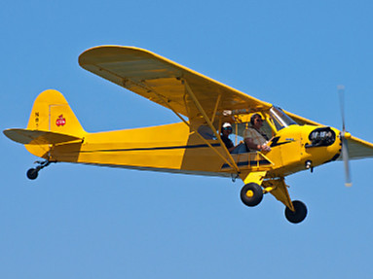
More of Todd’s Aviation Background
Initially, bike trainer to flight stick throttle innovation required elevated privileges.
Notes:
Flying without flight lessons or a pilot’s license is not unheard of. I thought I should be at least by at least familiar with a piper cub aeronautical characteristics.
Who can tell me the names of two people who flew without single a lesson?
I maintained my cycling abilities while living in the NE Ohio by riding a bike trainer.
I combined them and translated rear tire speed into a throttle position.

Slide 7
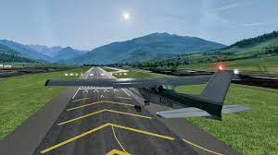
FlightGear
My configuration worked for me; but, no one knew about the bike trainer hardware / software I used.
After moving back home, I sought to revive this technology and improve upon it so it could be shared with others.
Above: link to FlightGear
Notes:
I shared my habit with few; When I started to live at my parents home …. I wanted to virtually fly again
I included a link to FlightGear on this slide.

Slide 8

Throttle Axis
Details: Playing a flight simulator with a joystick with a throttle axis is better than
just using a keyboard and mouse.
Throttle axis
Notes:
I enjoyed playing FlightGear so I purchased a flight stick…
That was not enough to me

Slide 9

Todd’s Bike on a Trainer
Details: I knew a bike on a trainer could be used to control the throttle axis.
Bottom bracket
Bike on trainer; sweat guards in place.
Sweat guards prevent corrosion.
I have already replaced the bottom bracket twice!
Notes:
I wanted to use my bike on the trainer again
Here is my bike on a trainer…
I try not to sweat; body sweat corrodes bottom bracket
Sweat guards prevent damage to your bike
I now take improved protective measures: I use fans to blow the sweat away now.
This is the bike in our basement

Slide 10

Speed Sensor Close-up
Details: How could the speed sensor on the rear wheel be used?
Speed sensor
A speed sensor is required! Above is a link to Amazon.com
Notes:
Initially, the sensor only work with a cell phone app. But, again, I was not satisfied. I knew I could do better. I captured its data with a R Pi.
Then on my linux desktop, and finally the Arduinos
I still wanted to share my quirk with Windows users.

Slide 11
What is an Arduino?
From “opensource.com”:
In a nutshell, an Arduino is an open hardware development board that can be used by tinkerers, hobbyists, and makers to design and build devices that interact with the real world.
Notes:
Here is a description of an Arduino

Slide 12
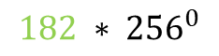

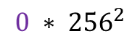
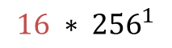
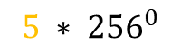
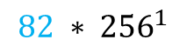
Math Used by Arduino Leonardo
Details: When the wheel is spinning, the speed sensor transmits, with blue
tooth low energy, information on the total number of spins and angular
speed of the last spin.
Here is an 8 byte transmission (that occurs every second unless the
speed sensor stops spinning for 2 minutes) [going forward, the
transmitted information will be referred to as an array of 8 unsigned bytes called rawValue]:
1 ,5 ,16 ,0 ,0 ,182 ,82 ,0
The total number of rotations is the sum of
The “last event”
8
Reverse IBM form
$$5 ∗ {256}^{0}$$
Total rotations
$$16 ∗ {256}^{1}$$
5+4096+0+0=4101
$$0 ∗ {256}^{2}$$
$$0 ∗ {256}^{3}$$
Last Event Time
$$182 ∗ {256}^{0}$$
182+20992=21174
$$82 ∗ {256}^{1}$$
Notes:
The Wahoo sensoir transmits 8 bytes every second
I learned this while using a linux based Raspberry PI – I use linux OS; not Windows. But my scheme still works for Windows users.

Slide 13

Programming Space Full
Details: Merely, capturing this stream of bytes filled the programming space of an Uno
WiFi Rev2 Arduino.
A second Arduino is required.
Note: The BLE signal from the speed sensor must be read by a sensor no
more than arms length away.
Important to remove power from this Arduino after each ride,
Otherwise it will continue to deplete the battery of the speed sensor
Notes:
Program storage space of Uno WIFI rev 2 filled
2nd Arduino Leonardo acts as the joystick…
Source code available on github.

Slide 14


Arduino In Use
Details: These 8 bytes of information are transmitted via the wire interface
(using the ground, SCL [serial clock], and SDA [serial data] pins) to an
Arduino Leonardo that can act as joystick.
Uno Wifi Rev2
Leonardo
Notes:
Leonardo and Uno Wifi Rev2 shown. Note the wires to channel information from the uno to the leonardo
I am not gifted at physical skills…this is the way I use it.

Slide 15
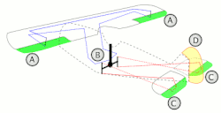
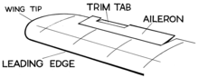
Aircraft Control Surfaces
Besides the throttle, there are other controls:
keyboard
surface trim tab
Bank aileron A 4,6 :,”
Pitch elevator C 2,8 1,7
Yaw rudder D - -
Auto-coordination between rudder and aileron in use
Keystrokes will be shown in upper center of this
screen during flight
Source: https://en.wikipedia.org/wiki/Flight_control_surfaces
Notes:
Here is an illustrations of the controls I use while flying.

Slide 16
Todd’s Email Address
Todd’s email: toddwestley@gmail.com
Some details in the Arduino code that I concede are mathy:
Constants
SpeedGradient, SpeedDelta, MaxSpreed
Using spreadsheet to determine speedGradient, speedDelta, maxSpeed
Notes:
Trainer resistance abates as it is used. How was this accounted for?
This is intended for those that want to understand details of how I transformed my bike.

Slide 17
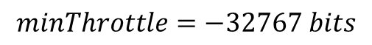
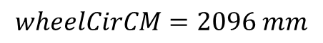
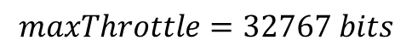
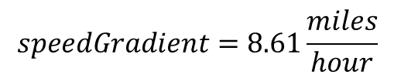
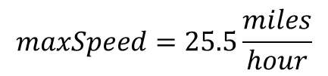
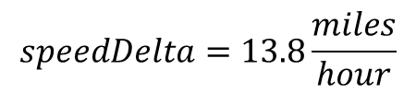
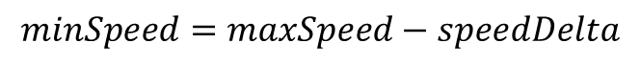
Constants
$$wheelCirCM=2096 mm$$
based on the type of tire. This for a 700CC X 23mm road tire
$$maxSpeed=25.5\frac{miles}{hour}$$
This the highest speed you could theoretically obtain after operating the trainer for a long time
$$speedDelta=13.8\frac{miles}{hour}$$
$$minSpeed=maxSpeed−speedDelta$$
$$speedGradient=8.61\frac{miles}{hour}$$
You pick this constant…help on this follows on the next slide
$$maxThrottle=32767 bits$$
This is the highest resolution possible
$$minThrottle=−32767 bits$$
Notes:
Constants
Wheel circumference can be found internet.
Note: I try to state units explicitly – this is a trick I used to pass the PE examination to eliminate incorrect answers on the multiple choice portion of the test.
I embedded a spreadsheet to use the serial output from you riding your bike on a trainer, to calculate your speedGradient.

Slide 18
SpeedGradient, SpeedDelta, MaxSpreed
How are SpeedGradient, SpeedDelta, and MaxSpeed defined?
I found something that worked for me…. Below is a link to a spreadsheet
You can adjust the parameters in cells L2:L3 see how they impact an actual ride (blue dots) from their use (red line). You can copy the contents to a new sheet and replace data in column A from one of your actual rides.
Notes:
I made an Excel worksheet so you can determine your own Speed Gradient, SpeedDelta, and MaxSpeed.

Slide 19
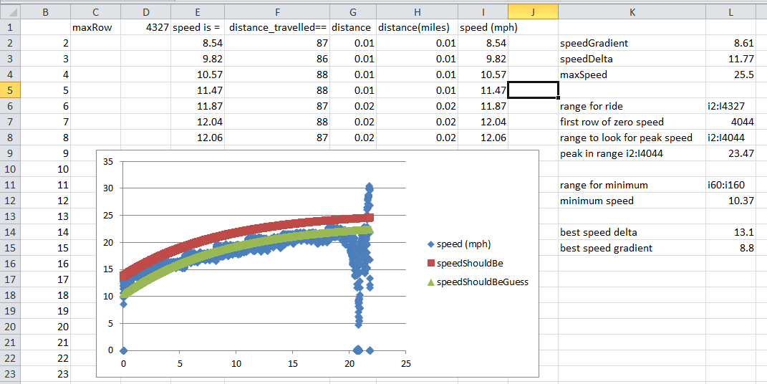
Using spreadsheet
Copy existing sheet into a new sheet
Delete existing serial output
Paste the serial output of your ride into the sheet!
The blue dots are your actual ride
Adjust the parameter in cell L15 until the green dots match the blue dots
Adjust parameters in cells L2:L4 until the red dots are just above blue dots

Slide 20
Questions
I put a lot of thought into how this works.
This diversion brought back the enjoyment of cycling to me. It brought variations from winds, temperatures, and altitude into the basement.
I also enjoy programming and relearning math
It’s not about physical fitness although that is a side effect. The activity, I believe, also led to a low resting heart [bradycardia] rate (<52 bpm).
Questions?
Notes:
When you watch me fly from KGAI to KBWI, I do not translate linearly from a Maximum speed to throttle position: I use more math and account for the trainer’s decrease in resistance from use.

Slide 21
Justification Why Todd is Presenting
Presentation Background
Presentation Publicly Available
How Todd Got Involved in Aviation
More of Todd’s Aviation Background
FlightGear
Throttle Axis
Todd’s Bike on a Trainer
Speed Sensor Close-up
Math Used by Arduino Leonardo
Programming Space Full
What is an Arduino?
Arduino In Use
Aircraft Control Surfaces
Todd’s Email Address
Constants
SpeedGradient, SpeedDelta, MaxSpreed
Using spreadsheet
Questions?
And/or
Watch Todd fly virtually from KGAI to KBWI [About 16 minutes]
Notes:
Questions?

Slide 22
Presentation Mechanics
What I did to present:
Wrote a batch file:
cd E:\CoolTermWin64Bit
start coolTerm.exe e:\coolTermWin64Bit\connection_settings_zero.stc
cd /d E:\ShowOff
start Showoff.exe
cd /D "C:\Program Files\FlightGear 2020.3\bin"
start /high fgfs.exe --launcher
Used CoolTerm to display Arduino Leonardo serial output
Used ShowOff to show user inputs in upper left of screen
https://www.dcmembers.com/skrommel/download/showoff/
Notes:
Show displays key strokes in upper left
NumPad 7 and Numpad 1 are elevator trim
Numpad 9 and Numpaf 3 are throttle
CoolTerm record text output from Arduino
Text output corresponds to throttle position
Distance gives me a clue if it is too early to shift
I like to record the text output – I am nerdy!

Slide 23
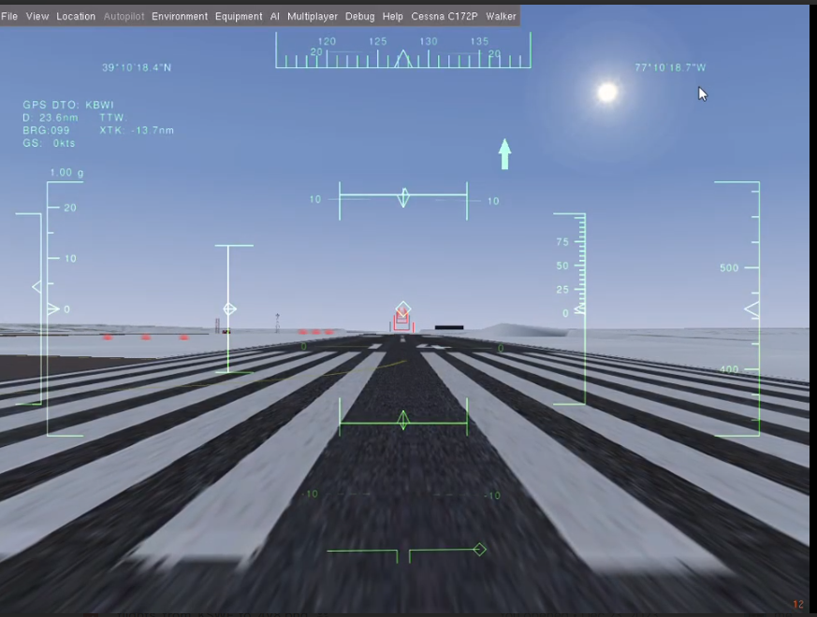
Pre-flight Briefing
GPS destination
Throttle
Air speed (knots)
Aileron (and trim)
Elevator (and trim)
Glide slope
Heading
Altitude above ground
Altitude above sea level
Rudder (auto-
coordination
in use)
Pre-flight briefing
video
Notes:
Here is the Heads Up Display I look at…
GPS, throttle, air speed, aileron (and trim), elevator (and trim), rudder, heading, altitude above ground, altitude above sea level
I takes about two minutes for the software to start running
The flight from Gaithersburg to BWI takes about 16 minutes.
I like to know the aircraft can still get airborne after lands
Center control surfaces and then take off

Slide 24
Presentation Publicly Available
This presentation is publically available on github:
https://github.com/toddwestley/Arduinos-to-turn-equipped-bike-into-Joystick-with-throtle-axis so you can download these slides.
Search on google for “toddwestley site:github.com”
Notes:
Link to slides; I mispelled throttle; google search for ‘toddwestley site:github.com”
This presentation is about two boring activities: riding a bike trainer and playing a flight simulator.
Combining them rendered an enjoyable activity -- In spite of disability, I still can enjoy cycling.
Lots of hyperlinks in this presentation.

Slide 25
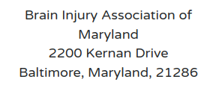
I am in debt to the Holy Spirit for gently encouraging me to move forward on this project.
If you are moved, please make a donation to:

Slide 26
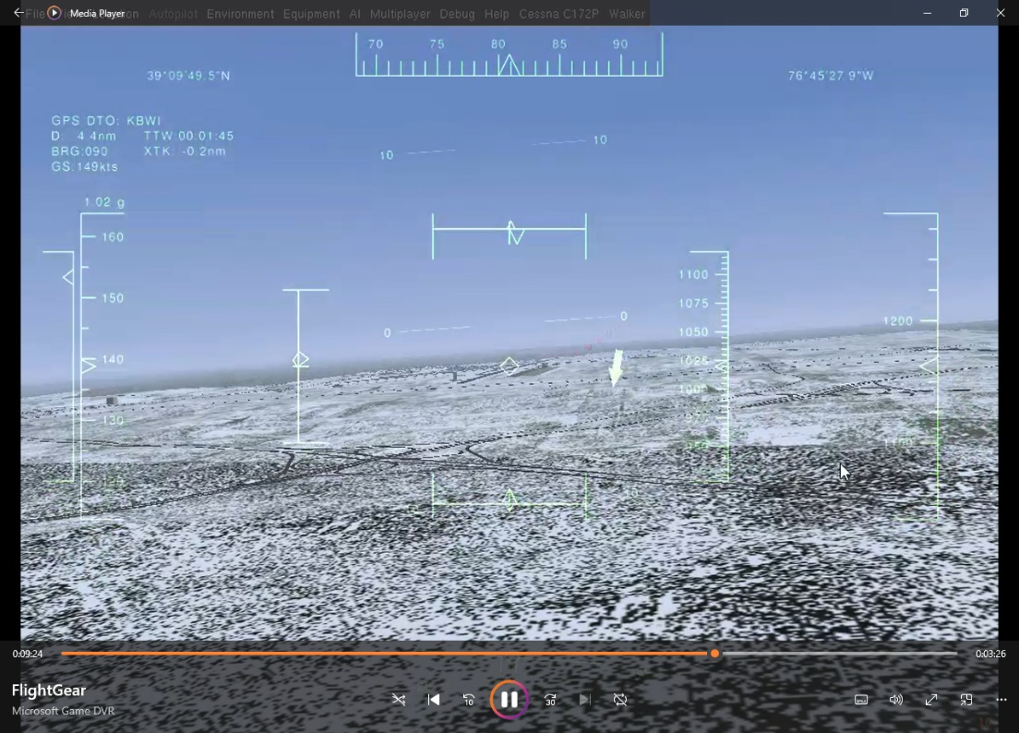
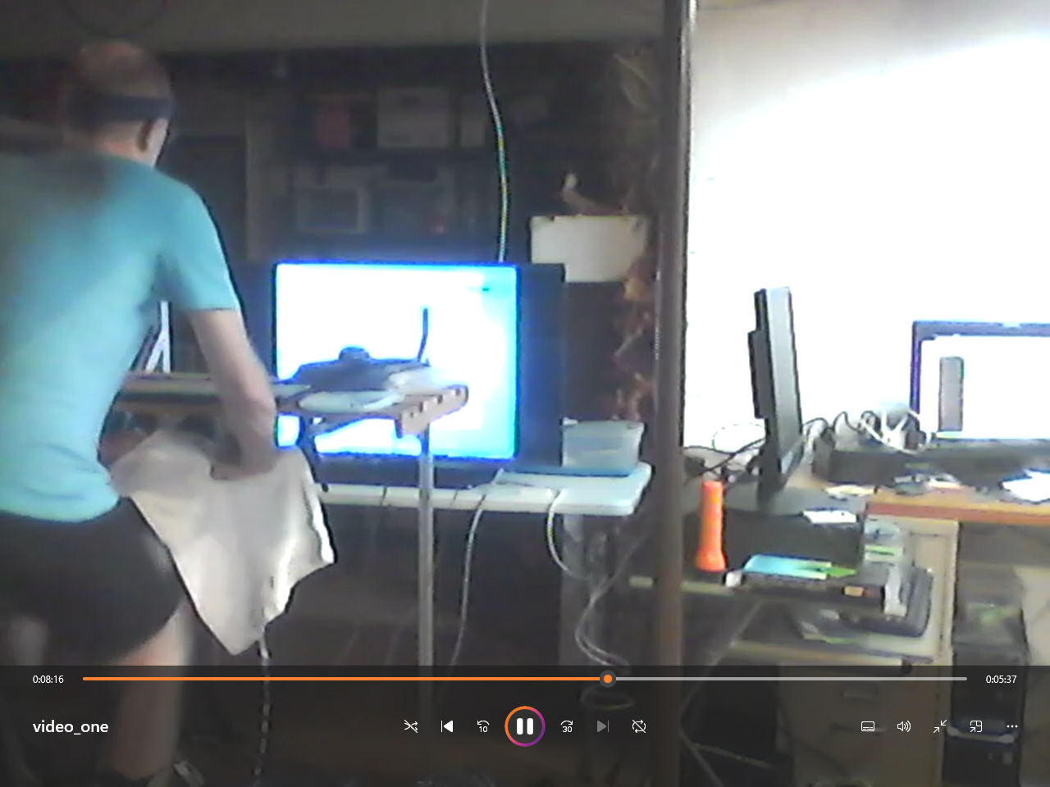
Video of a flight
Video of Todd on a Trainer
back

Slide 27
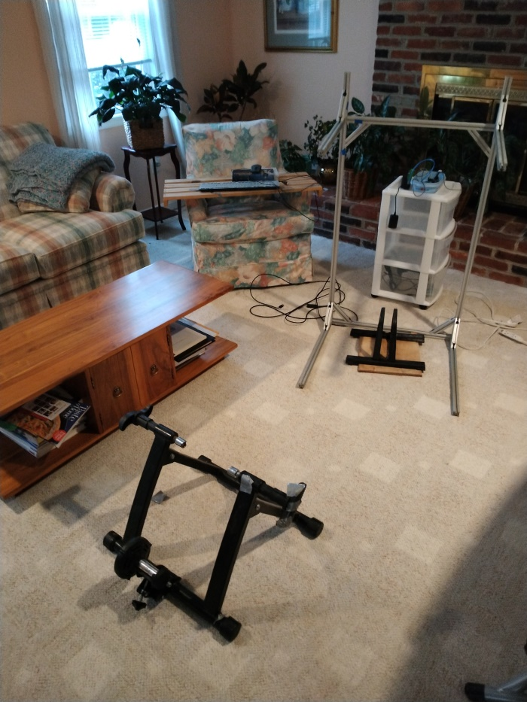
8020 structure to hold plank
Plank
Mouse
Mouse Pad
Mouse Pad support
Keyboard
Cover for key board
Structure for Arduinos
Arduino Leonardo
Arduino Uno Wifi Rev 2
Tupperware to hold Arduinos
USB hub
USB Type B cable for Uno Wifi Rev2
USB cable for Leonardo
3 wires for Arduino communication
Front wheel support and board to raise whl. spt.
Bike Trainer
Bike (not shown; with speed sensor)
Fans (not shown)
Screen (not shown)
PC (not shown)
What will Todd use to exhibit this feat?

Slide 28
Todd’s list
Starter list
8020 structure to hold plank
Plank
Mouse
Mouse Pad
Mouse Pad support
Keyboard
Cover for key board
Structure for Arduinos
Arduino Leonardo
Arduino Uno Wifi Rev 2
Tupperware to hold Arduinos
USB hub
USB Type B cable for Uno Wifi Rev2
USB cable for Leonardo
3 wires for Arduino communication
Front wheel support and board to raise whl. spt.
Bike Trainer
Bike (not shown; with speed sensor)
Fans (not shown)
Screen (not shown)
PC (not shown)
Ironing board
Plank
Mouse
Mouse Pad
Mouse Pad support
Keyboard
Cover for key board
Structure for Arduinos
Arduino Leonardo
Arduino Uno Wifi Rev 2
Tupperware to hold Arduinos
USB hub
USB Type B cable for Uno Wifi Rev2
USB cable for Leonardo
3 wires for Arduino communication
Front wheel support and board to raise whl. spt.
Bike Trainer
Bike (not shown; with speed sensor)
Fans (not shown)
Screen (not shown)
PC (not shown)
Notes:
I would not omit the items greyed out; you could though

Slide 29
What if my laptop computer has bluetooth already!
Linux → Great: I already wrote software (modified gatttool)
SUDO required each time the software is executed
Windows → I wrote software that Google suggests got a virus
Software written in VisualStudioCode : 20 Gigabyte download

Slide 30
Possible questions:
Did you make a quiz so Ohio PE’s could earn a CEU?
Can you better illustrate/explain the math involved?
Could have used a Laplace transform?
Can you explain the parameters that dictate the throttle position?
Did you know trainer resistance fades during their use? Did you take this into account?
How do turn on/off the glide slope indicator?

Slide 31
How can I do this?
Get a trainer, Wahoo sensor, Arduino Leonardo, Arduino Uno Wifi Rev2
You may want a 60mm OD x 3.5mm wide o-ring
Get at least a something to absorb your sweat
Get bike trainer
Program the Arduinos
Make a desk to go over your bike on the trainer
Buy keyboard and water shield for the keyboard
Learn the MAC address of your Wahoo sensor
Use cell phone App LightBlue
Rewrite the code of the Arduinos
You need the MAC address for the Uno Wifi Rev2
You need to set you parameters for Leonardo code
There is a spreadsheet embedded to help you
Ride the trainer for a exercise period of choice (I used 1 hour)
Learn to use flight simulator
KTTS in Florida is a 3 miles long by 300 feet wide!
Post your questions on GITHUB and I will answer them there.

Slide 32
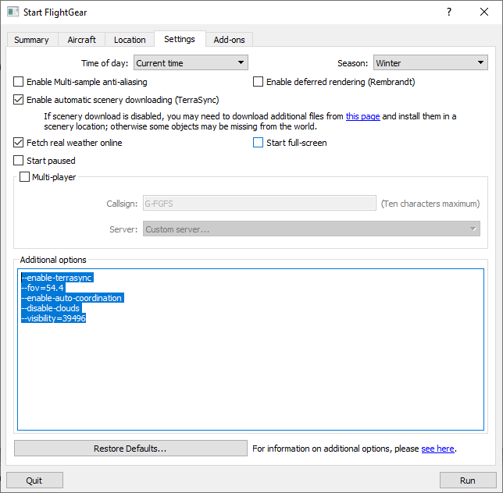
What I did to present:
Wrote initial conditions for FlightGear:
--enable-terrasync
--fov=54.4
--enable-auto-coordination
--disable-clouds
--visibility=39496
Modified keyboard XML:
--enable-terrasync
--fov=54.4
--enable-auto-coordination
--disable-clouds
--visibility=39496

Slide 33
Details: This is very math centric…Formulas used in the Arduino programs I authored include:
Constants
“RawValue” description
Speed calculation
Joystick throttle axis position calculation
Notes:
What follows in math intense….It took me 6+ years to get here. Frankly, I would have reviewed this presentation numerous times if it had been available.

Slide 34
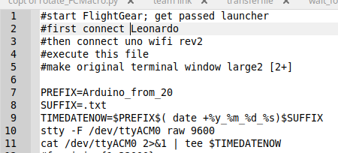
This is nerdy, and I am pretty sure the Arduinos are working even if their serial outputs are not visible, but, I like to know they are working (and how hard I am working the bike) while playing FlightGear so I wrote this Linux script.
You can also use the serial monitor on Arduino IDE to view the output from the Arduino Leonardo.
Notes:
I use Linux; it is possible to do this on Windows.

Slide 35
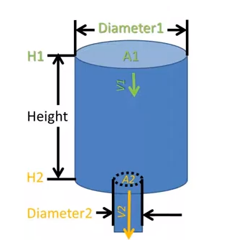
Details: Why use an exponential function?
Think of your effort on the bike trainer as a stream of water. Think of
your bike trainer as a tank for that water. That tank has a small hole at
the bottom. Water leaves that tank at a rate proportional to its height. As
time goes on, the tank will reach a constant level. That water (trainer
temperature) represents the resistance of your trainer. As time passes, the
resistance decreases and you pedal faster. This produces a differential
(i.e. difficult) equation whose solution includes an exponential function.
https://www.youtube.com/watch?v=-1ARYph3mNA
Notes:
I used a high school junior to help me solve a differential equation equivalent to understanding water flow into a tank (with constant cross-section) with a hole at its bottom.
I put much thought into using a decaying exponential function.

Slide 36
I am in debt to the Holy Spirit for gently encouraging me to move forward on this project.
If you are moved, please make a donation to:

Slide 37
Thing left to do:
add slides to show how to define speedDelta, maxSpeed, speedGradient
what is an Arduino?
make a quiz
make a box for Arduinos
order USB cables
email Bryan Pugh about presenting next year
offer CEUs to other PEs
oring for speed sensor
Annex
What I did to make flightgear run on Windows two – DLLs
vcruntime140_1.dll
msvcp140.dll
Windows CoolTerm vs Linux script to record Serial Output of Leonardo
Comparison of joystick set up
spellung error on github

Slide 38
Cost Analysis for potential end user
Assumptions: Potential users have a bike only and will consider Windows 10 PC only.
Amazon or McMasterCarr will be sole source of products
Potential users have space for this stuff:
Trainer stand 34.99
Desktop PC w/ Monitor 131.50
Arduino Leonardo w/cable 14.99
Arduino Uno Wifi Rev2 (abx00021) 54.96
Wahoo Speed Sensor 39.99
Fan 39.99
4 port USB port w/ power switches 16.95
Keyboard cover *must match PC’s keyboard! 13.99
Trainer Sweat Guard 9.99
80/20 Material to make shelf to go over handle bars 234.75 Arduino Jumper Wires [you should be able to find these!] 1.99
USB cable for Arduino Uno 6.99
Total 651.08+shipping
Green from McMaster Carr

Slide 39
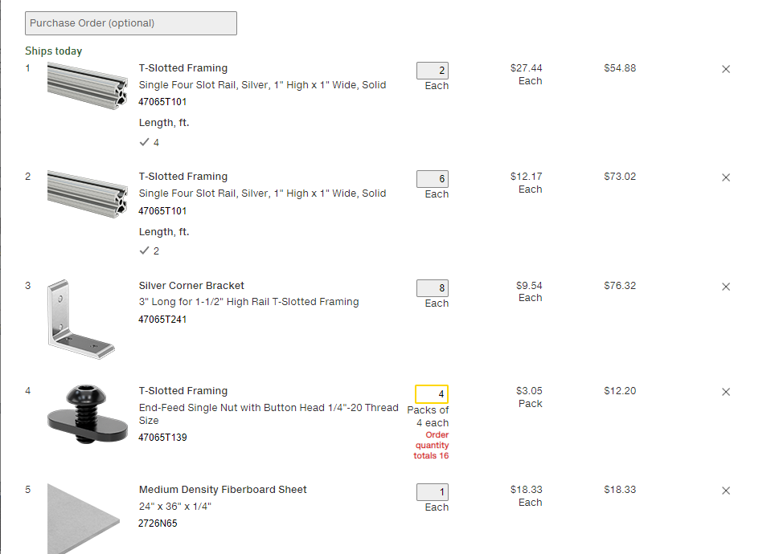
234.75

Slide 40
Wow, $651.08 + shipping! I thought Todd had a fixed income.
I rode a trainer stand, prior to Oct 29, 2014. After that day I rode that a trainer stand for a few weeks before I severed the shaft leading to the trainer stand’s fly wheel. I also used that trainer to control the throttle axis with a USB-1208LS. I already had an affinity for the Linux PC I have – I was frugal and liked to program.
Arduino are open source and appeal to hobbyists: I challenge you to find a more economical alternative.
Cheaper ANT+ speed sensors are available. I am unwilling to deviate.
In Elyria, I kept my apartment at 55°F – the furnace was loud; the lease did not allow me to go lower. When I moved back home, other residents preferred a warmer temperature. I try not sweat.
I did not know how to find a shelf: I built one from materials I knew about. Surely you can find a cheaper alternative.
From the USB-1208LS, I had a type B USB cable for the Arduino Uno Wifi Rev2
I have oodles of jumper wires: if you need some, come by my residence and I will give you some.

Slide 43
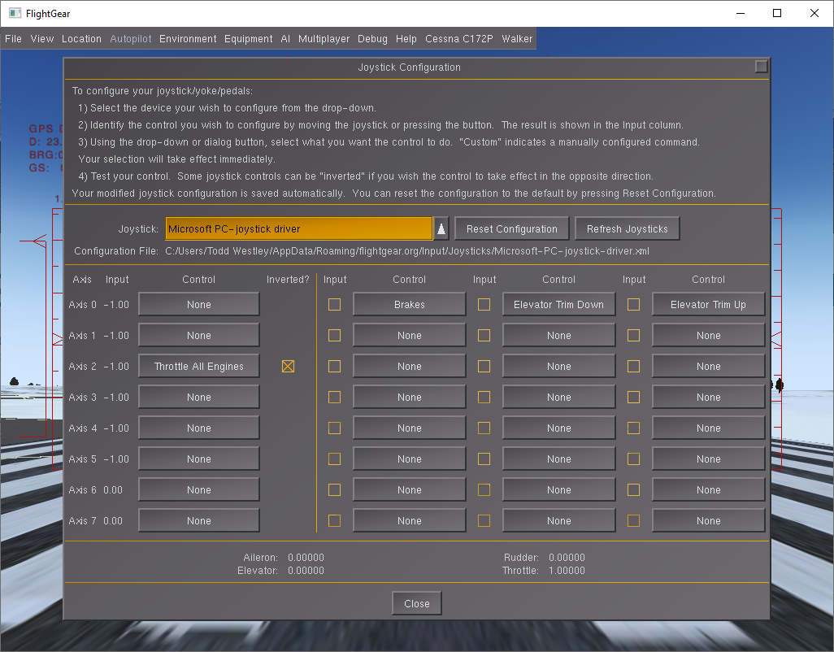
Comparison of Joystick configurations – Windows, Microsoft takes credit.

Slide 44
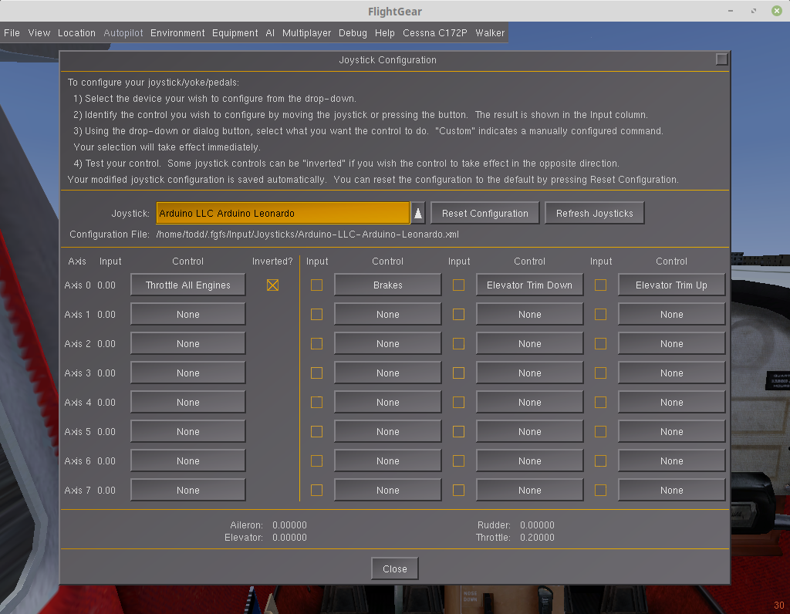
Comparison of Joystick configurations – Linux, Arduino LLC takes credit

Slide 45
What I did to make FlightGear run on Windows – two missing DLLs
vcruntime140_1.dll -- followed instructions on YouTube
msvcp140.dll -- found on hard drive and copied
into FlightGear directory
If I did this over again, I would install and run CoolTerm first, then FlightGear

Slide 46
I like to see and have a record of the Serial Output from the Leonardo. On linux, I use this script file
[batch file]:
PREFIX=Arduino_from_20
SUFFIX=.txt
TIMEDATENOW=$PREFIX$( date +%y_%m_%d_%s)$SUFFIX
stty -F /dev/ttyACM0 raw 9600
cat /dev/ttyACM0 2>&1 | tee $TIMEDATENOW
The same can be accomplished on Windows by using CoolTerm…

Slide 47
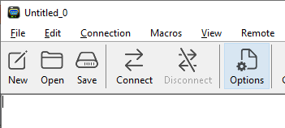
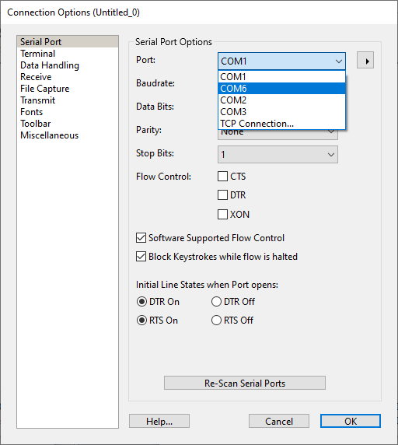
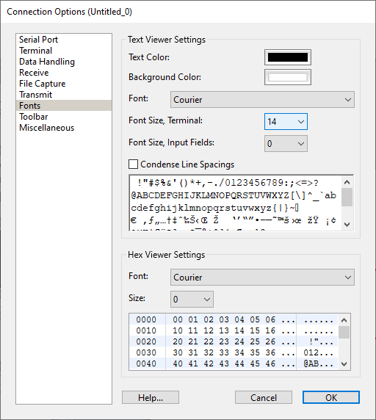
Download and install coolterm
launch cool term
click options
Select Leonardo port
you can learn this from the
Arduino IDE
Click fonts
change font size to as desired

Slide 48
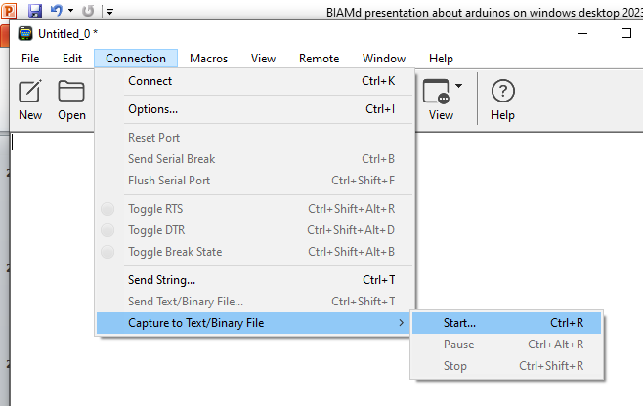
Click connection menu >> capture to Text/Binary File >> start

Slide 49
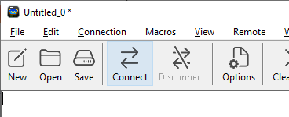
Select a name as prompted…
Click connect
Plug USB cable into Uno Wifi Rev 2 Arduino (this causes the Arduino to restart)
Start FlightGear, select departure airport, etc. …get past launcher,
after cockpit is visible… Start pedaling – Serial Output data will appear,
When ride is complete…
Unplug the Uno Wifi Rev 2
Connection >> Capture to Text/Binary File >> stop
Disconnect Serial
Quit – Don’t save settings
If desired, analyze the ride to (Select topSpeed, deltaSpeed, and speedGradient)

Slide 50
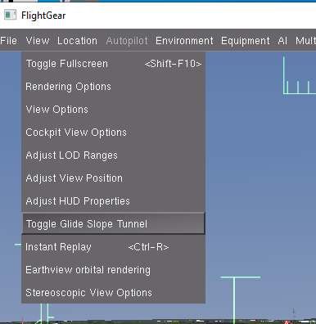

Slide 51
startApps batch file used
@echo off
cd E:\CoolTermWin64Bit
start coolTerm.exe e:\coolTermWin64Bit\connection_settings_zero.stc
cd E:\ShowOff
start Showoff.exe
cd E:\FlightGear 2016.4.4\bin
start fgfs --launcher
exit
Notes:
How I would capture serial output…
I used flightgear 2016 so flightgear would fit on a jump drive.
On coolTerm, don’t forget to <ctrl> r to start recording.

Slide 52
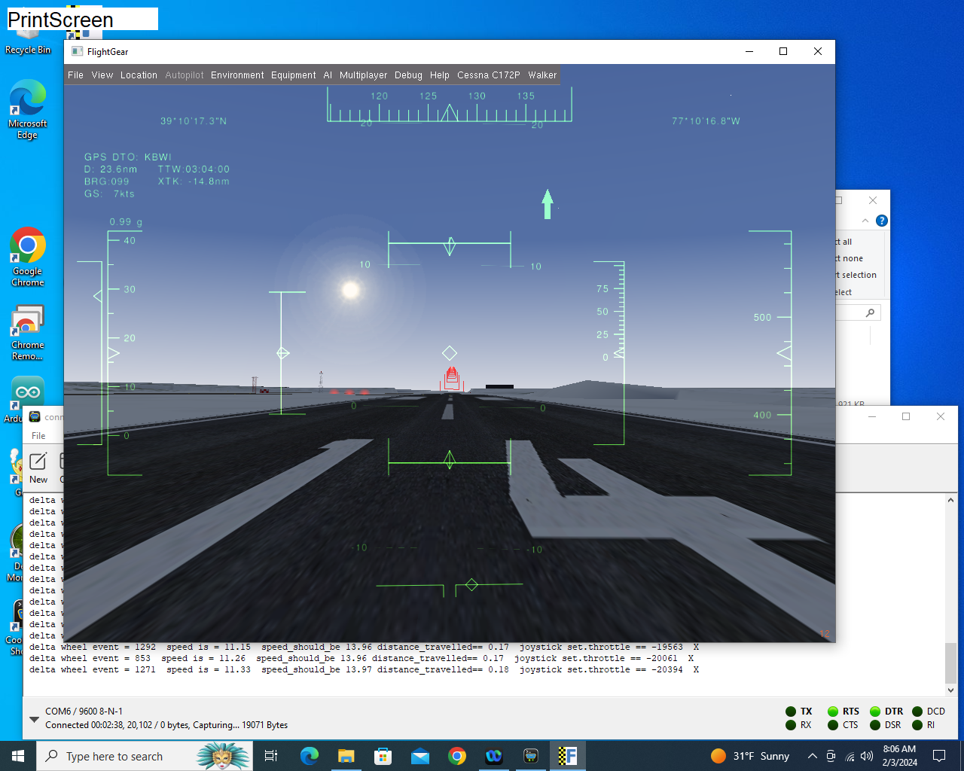

Slide 53
This presentation is publically available on github:
https://github.com/toddwestley/Arduinos-to-turn-equipped-bike-into-Joystick-with-throtle-axis so you can download these slides.
Search on google for “toddwestley site:github.com”
Summary: In my humble opinion, riding a bike trainer is mind numbing.
Playing a flight simulator (without warping time) is equally mind numbing.
In combination, they lead to a palatable activity for me.
I discovered that I could play games in plain sight of those around and they incorrectly conclude the activities are only exercise.
I now can plan the nature of my exertions, i.e. how fast can I climb that hill?, and include variations from real world weather.
This presentation is about my quirky leisure activity.
Notes:
Link to slides; I mispelled throttle; google search for ‘toddwestley site:github.com”
This presentation is about two boring activities: riding a bike trainer and playing a flight simulator.
Combining them rendered an enjoyable activity -- In spite of disability, I still can enjoy cycling.
Lots of hyperlinks in this presentation.

Slide 54
It all began when my Uncle Steve was building a Piper cub from scratch while I lived in Ohio. In the winter, it was too cold for me to ride my bike outside. I rode a trainer, but it was boring. Than I decided to couple that with playing a flight simulator that had a piper cub aircraft. I used as USB-1208LS to capture the “:speed” of my rear wheel and my PC translated that into a throttle position. At that point, I got in the habit of virtually flying.

Slide 56
Hamm’s suggestions
Header each slide
Should url of presenation go first
Why did you want to control a simulator with you bike
Speed sensor picture; bottom bracket picture
Picture of Todd on the trainer

Slide 57
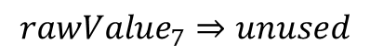
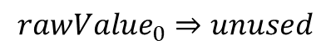
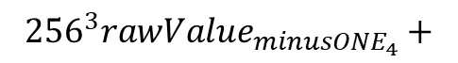
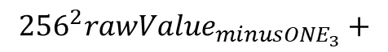
Rotations Math
$${rawValue}_{0}⇒unused$$
$$currentRotation={rawValue}_{1}+{256}^{1}{rawValue}_{2}+{256}^{2}{rawValue}_{3}+{256}^{3}{rawValue}_{4}$$
previous$Rotation={rawValue}_{{minusONE}_{1}}+{256}^{1}{rawValue}_{{minusONE}_{2}}+$
$${{256}^{2}rawValue}_{{minusONE}_{3}}+$$
$${{256}^{3}rawValue}_{{minusONE}_{4}}+$$
$${rawValue}_{7}⇒unused$$
Notes:
Total rotations from rawValue

Slide 58


Speed Calculation
$$aproximateSpeed=\frac{\left(currentRotations−previousRotation\right)∗wheelCircm}{\left(\frac{1000mm}{1m}∗\frac{1000m}{1km}\right)}∗\frac{miles}{km}∗\frac{3600seconds}{hour}$$
$${wheelEvent}_{current}={rawValue}_{5}+256∗{rawValue}_{6}$$
$${wheelEvent}_{previous}={rawValue}_{{minusOne}_{5}}+256∗{rawValue}_{{minusOne}_{6}}$$
$$deltaWheelEvent={wheelEvent}_{current}−{wheelEvent}_{previous}$$
or
$$deltaWheelEvent={wheelEvent}_{current}−{wheelEvent}_{previous}+2^{16}$$
$$0≤deltaWheelEvent≤2^{16}$$
$$currentSpeed=\frac{approximateSpeed∗1024}{deltaWheelEvent}$$
Notes:
Speed calculation
Delta wheel event must be positive

Slide 59
Throttle Position Calculation
$$distanceTravelled=\left(currentRotations∗wheelCIRCM\right)∗\frac{kilometer}{mile}∗\frac{mm}{meter}∗\frac{meter}{km}$$
$speedShouldBe=−exp\left(\frac{−distanceTravelled}{speedGradient}\right)$*speedDelta+maxSpeed
$$joystickThrottleValue=\frac{currentSpeed}{speedShouldBe}∗\left(maxThrottle−minThrottle\right)+minThrotttle$$
Notes:
Joystick throttle position calculation
Note the exponential function used – this accounts the lack of resistance as the trainer is used.

Slide 60
--enable-terrasync
--fov=54.4
--enable-auto-coordination
--disable-clouds
--visibility=39496

Slide 61
Why does the 2032 battery inside the sensor go dead so quickly?
I had problems when I failed to turn off the Arduino Wifi Rev2 after every ride: I think the arduino “subscribes” to the sensor and does not unsubscribe.
You can monitor the battery by using cell phone app “LightBlue”
2024 May 13 → I was turning off the Arduino Wifi Rev2 by disconnecting the usb cable. I have USB hub with off on switches and started using it today. It is necessary to disconnect the uno wifi rev2 or unsubscribe (I think)

Slide 62



Slide 63


